Slide 1
Common Development
UML- Class and Sequence Diagrams

Slide 2
Module objectives
After completing this module you will be able to:
Describe the two different categories of UML diagrams
Explain the use of Use Case, Activity, Class and Sequence diagrams.
Demonstrate the use of class and sequence diagrams to design a real world application

Slide 3
Data Modelling with UML
UML
Web Application Design Recap
Web Application Design Recap
Object Oriented Programming
Class Diagrams
Sequence Diagrams

Slide 4
UML
Unified Modelling Language
What is it used for?
  Object Oriented Design
  Data structure modelling
  Scenario modelling
  Logical flow modelling
Two categories
  Structural
  Behavioural

Slide 5
Data Modelling with UML
UML
Web Application Design Recap
Object Oriented Programming
Class Diagrams
Sequence Diagrams

Slide 6
Use Case Diagram
Behavioural
High level view, from the perspective of outside the system
Models interaction between things external to the system (actors) and functionality within the system (use cases)

Slide 7
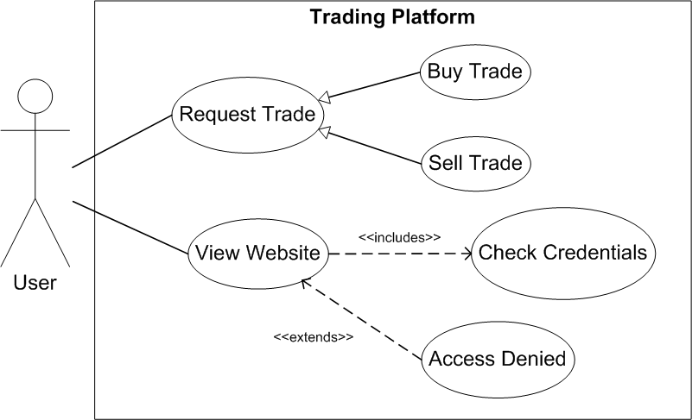
Use Case Diagram
Generalisation
A more specific form of the functionality
Includes
Required for the use case to be fulfilled
Association
Interaction between actor and use case.
Extends
Result from conditional logic (e.g. access denied if credentials check fails)

Slide 8
Activity Diagram
Behavioural
Low level view
Models logical flow of the system

Slide 9
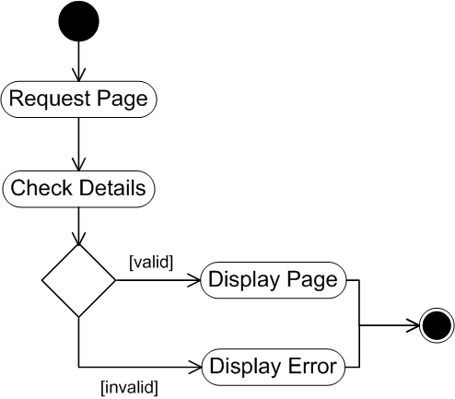
Activity Diagram
Initial node
Flow
Action
Possible outcomes
Final node
Decision
Result of decision

Slide 10
Data Modelling with UML
UML
Web Application Design Recap
Object Oriented Programming
Class Diagrams
Sequence Diagrams

Slide 11
Object Oriented Programming Overview
OOP is a way of building software
It is modular, with the class as the primary building block
Classes contain
  Behaviour (things that they do)
  Attributes (properties/state)

Slide 12
Object Oriented Programming Example
A Class is a blueprint
An Object is a real thing made from that blueprint
Discuss
What is the difference between the blueprint of a car and an actual car?

Slide 13
Data Modelling with UML
UML
Web Application Design Recap
Object Oriented Programming
Class Diagrams
Sequence Diagrams

Slide 14
Class Diagram
Structural
Models the classes within an OOP program, including:
  Their attributes and behaviours
  Their relationships with other classes
Arrows model relationships, not flow

Slide 15
Class Diagram – Class
ClassName
- privateAttribute : int + publicAttribute : String # protectedAttribute : long
- privateMethod(String argument) + publicMethod() : String # protectedMethod ()
Name of the class
Attributes
Behaviours

Slide 16
Class Diagram – Abstract Classes and Interfaces
AbstractClassName
An abstract class is represented using italics
An interface is represented with <<interface>>
<<interface>> InterfaceName
Research (10 mins)
What are Abstract classes and interfaces used for?
What are the differences between them?

Slide 17
Abstract classes & interfaces
Used for generalisation
You cannot instantiate either of them
  Need to use a more specific form
Discuss the difference between a Vehicle and a Car/Motorbike

Slide 18
Class Diagram – Inheritance Connectors
Generalisation
  One thing 'is a' type of another thing
  Broker 'is a' user
Realisation
  Implements an interface
Broker
User
Shareholder
Broker
<<interface>> Automated
Shareholder

Slide 19
Class Diagram – Dependency Connectors
Name | Diagram | Description
Dependency |  | Used in a method Teller ‘uses a’ Account object in a method
Association |  | Database ‘has a’ connection object as variable
Aggregation |  | Exchange ‘has many’ Broker objects Broker can exist outside the Exchange
Composition |  | StockIndex ‘requires’ Exchange, Exchange ‘has many’ StockIndex's
Teller
Account
+ getInfo(Account)
Database
Connection
Exchange
1..*
1..*
Broker
Exchange
1
1..*
StockIndex

Slide 20
Class Diagram
What relationships exist between the classes in the following slides?

Slide 21
Class Diagram
InventoryItem
-price
+setPrice()
Book
-author
+setAuthor()
DVD
-manufacturer
+setManufacturer()

Slide 22
Class Diagram
Company
Employee

Slide 23
Class Diagram
Client
Supplier

Slide 24
Class Diagram
Schedule
Student
-studentName -studentId
Course
-courseNumber -courseName

Slide 25
Class Diagram – Exercise (15 mins)
Produce a class diagram to model an online shopping website where a customer can complete an order

Slide 26
Data Modelling with UML
UML
Web Application Design Recap
Object Oriented Programming
Class Diagrams
Sequence Diagrams

Slide 27
Sequence Diagrams
Behavioural
Models a single scenario for a single process
Shows the interactions that take place between classes involved in that process
Example- The login process
  A successful login would be one scenario
  An unsuccessful login would be another scenario

Slide 28
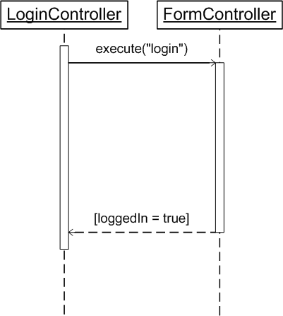
Sequence Diagram - Components
Actor/Class
Activation
Method call
Return value
Lifeline

Slide 29
Sequence Diagrams – Internal Method Call
What if a method calls another method in the same class?
Object
otherMethod(arg)

Slide 30
Sequence Diagrams – Decision Logic
How do you represent an if statement on a sequence diagram?

Slide 31
Source: http://www.ibm.com/developerworks/rational/library/3101.html
Bank
Cheque
Account
getAmount()
amount
getBalance()
balance
alt
[balance >= amount]
addDebitTransaction(checkNo, amount)
[else]
addInsufficientFundsFee()
returnCheque()

Slide 32
Sequence Diagrams - Structure
How do we represent a loop in a sequence diagram?
Example
In the previous example, what if a customer had 5 cheques and we needed to repeat the process?
loop
[for each cheque]

Slide 33
Class Diagram – Exercise (15 mins)
For your shopping website, produce a sequence diagram to represent a scenario where an order is processed.

Slide 34
Module review
What is UML?
What are the two categories of diagram?
What is a Use Case diagram?
What is an Activity Diagram?
What is a class diagram?
What are the different forms of dependency in a class diagram?
What is a sequence diagram?
How do you represent if statements and loops in a sequence diagram?

Slide 35
Module objectives
Now you have completed this module you should be able to:
Describe the two different categories of UML diagrams
Explain the use of Use Case, activity, class and sequence diagrams.
Demonstrate the use of class and sequence diagrams to design a real world application

